Slide 1
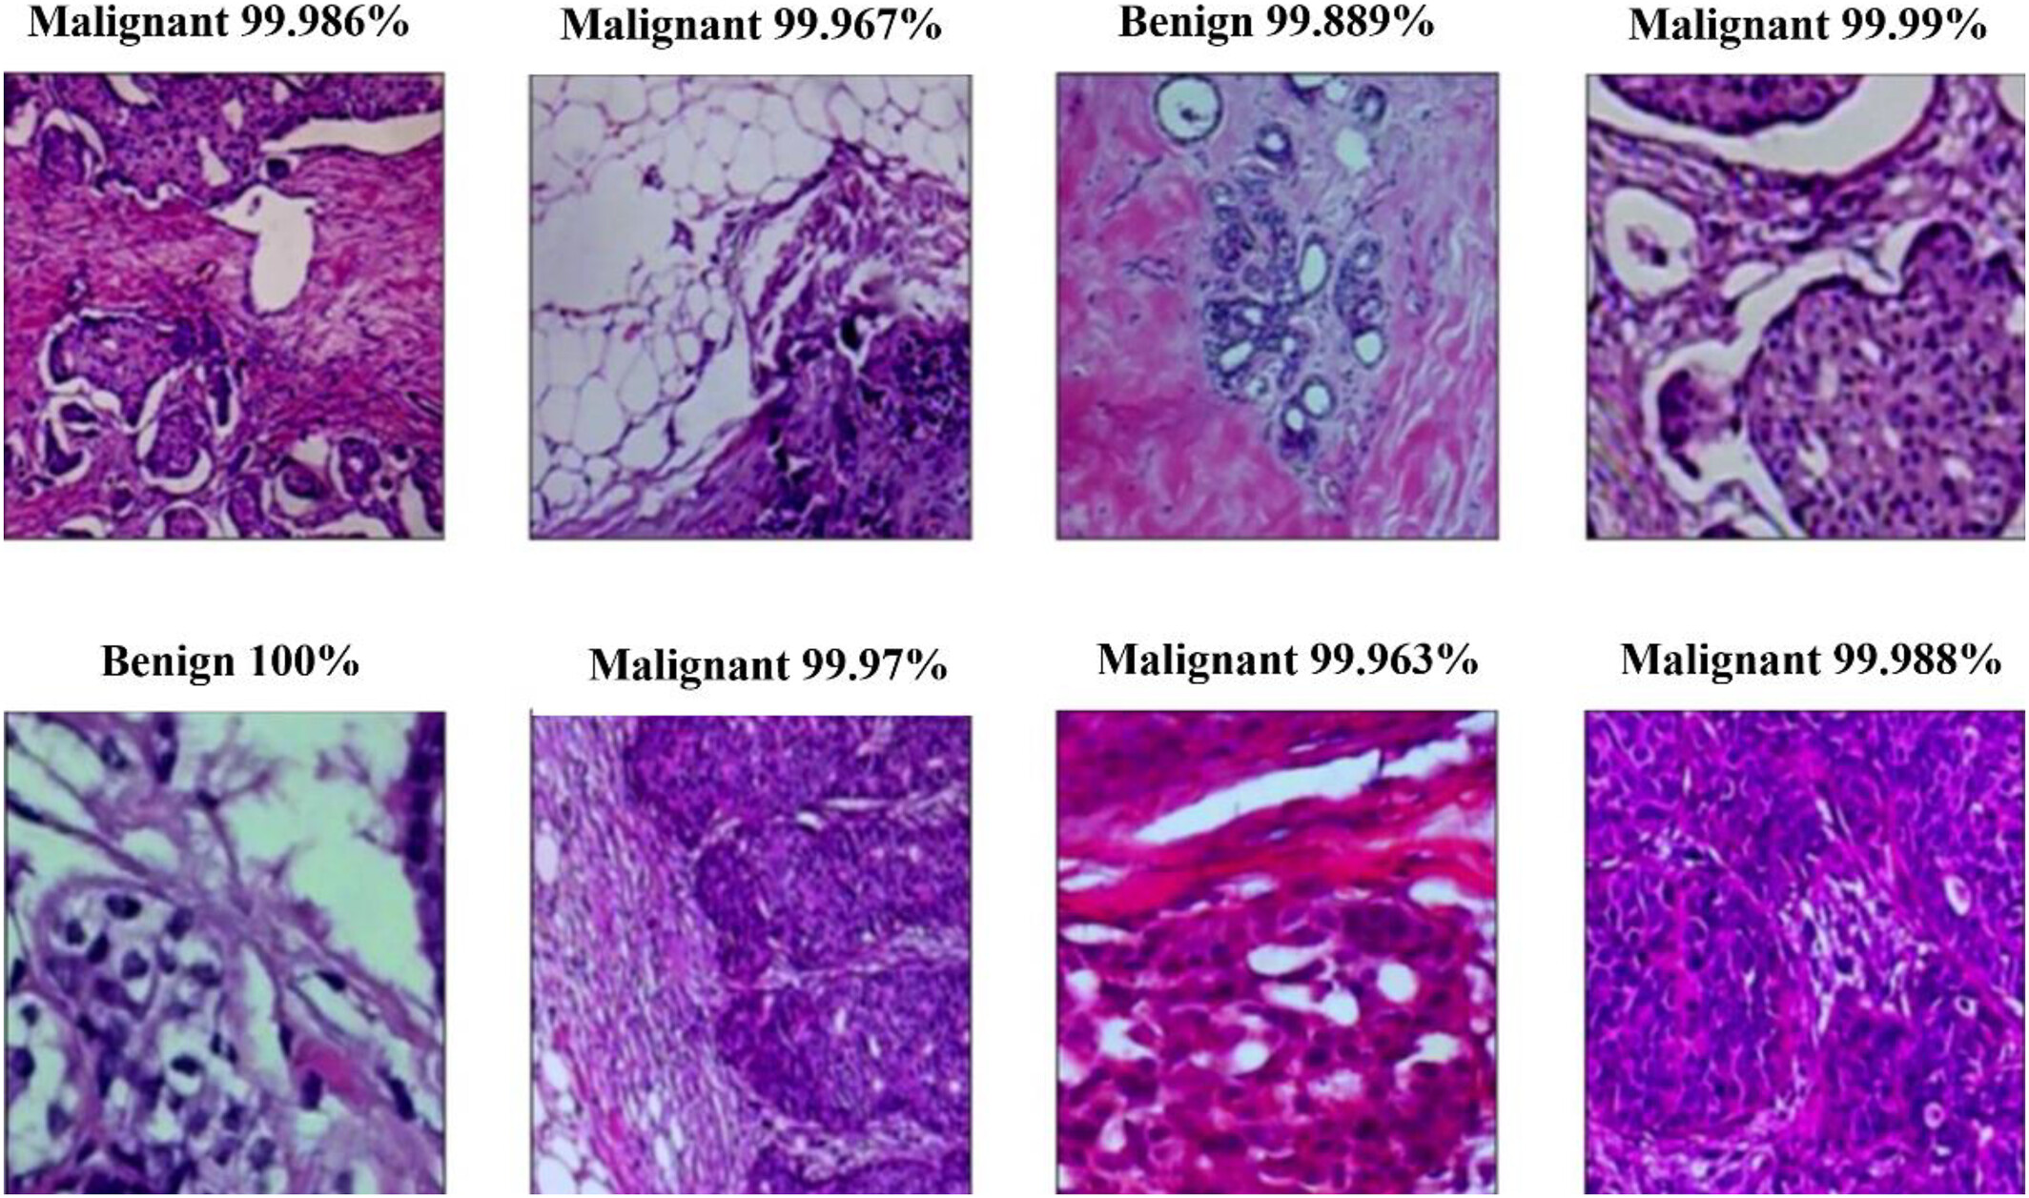
Breast Cancer Classification Using Histopathology Images
By:
Naisargi Sharma (100868470)
Ujas Patel (100861677)
Vaibhav Jaiswal(100862758)
DATE:04/07/2025
AL_700_001_BK_SPRING2025

Slide 2
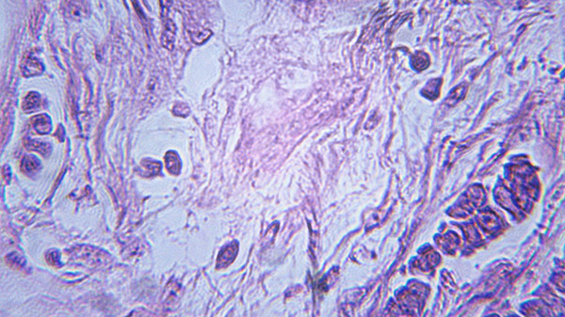
Outlines
Introduction
Application
Type of Tumor
Obtained Results
Conclusion & Future Work
References
Questions
Algorithm/Approach
Model Architecture

Slide 3
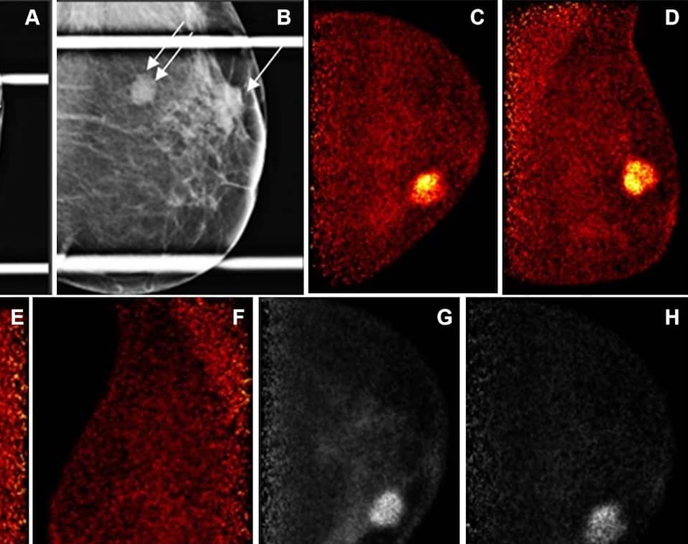
INTRODUCTION
Breast cancer is one of the most common cancers affecting women globally.
Early diagnosis and accurate classification are crucial for patient outcomes.
Histopathology images are the gold standard for diagnosis, but manual analysis is time-consuming.
AI and CNNs help automate and improve classification performance.

Slide 4
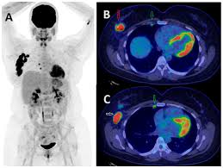
APPLICATION
Medical Diagnosis: More accurate detection of malignant cells.
Clinical Support: Assists doctors in decision-making.
Personalized Treatment: Facilitates treatment based on subtype.
Healthcare Efficiency: Reduces time and burden on pathologists.

Slide 5
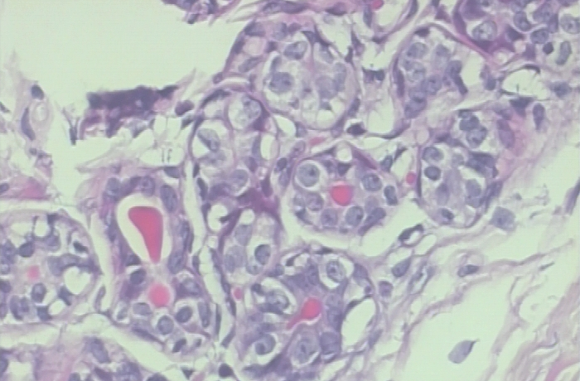
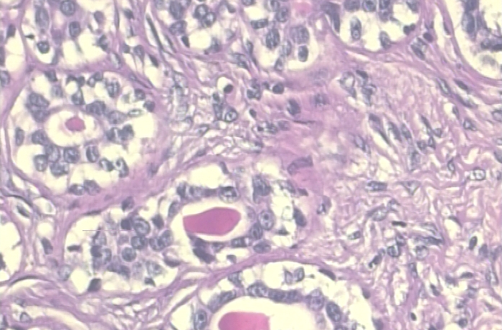
Benign Tumors:
Adenosis: A benign proliferative condition in the breast where there is an abnormally high number of acini (glandular structures) within the breast lobules. It can sometimes mimic invasive carcinoma on imaging, especially in sclerosing forms.
Fibroadenoma: A common benign tumor made up of both epithelial and stromal tissue. Typically found in women between 15 and 35 years of age. Variants include simple fibroadenoma and complex fibroadenoma. It is usually firm, mobile, and non-tender.

Slide 6
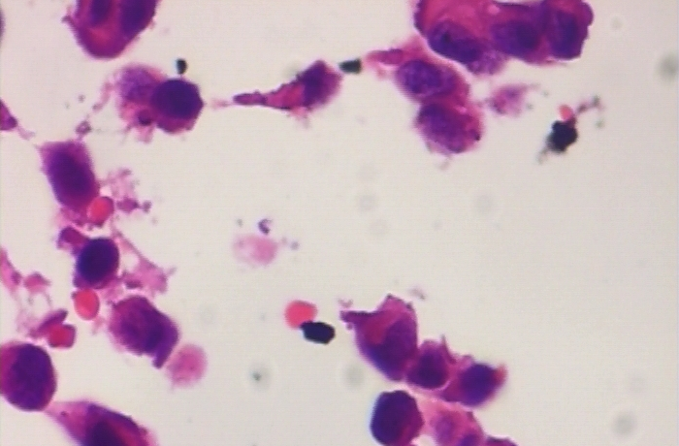
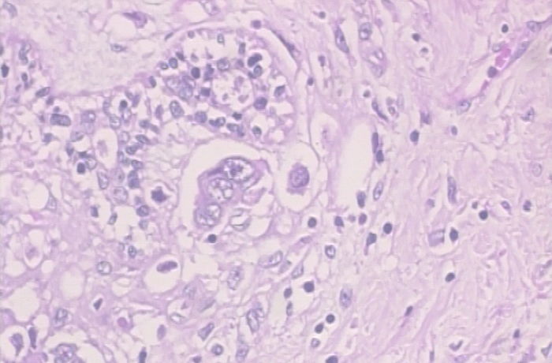
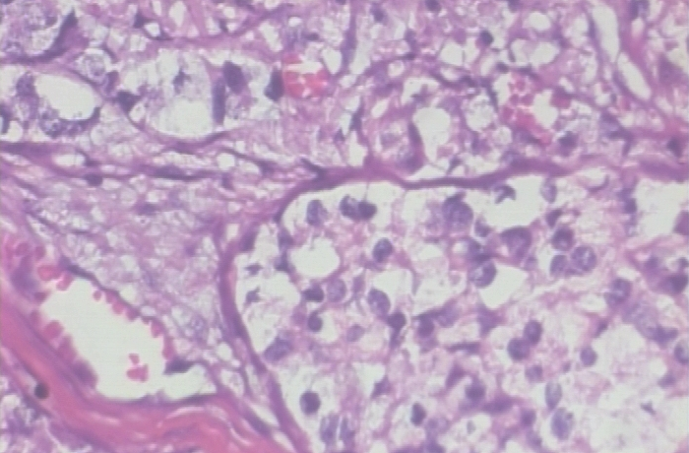
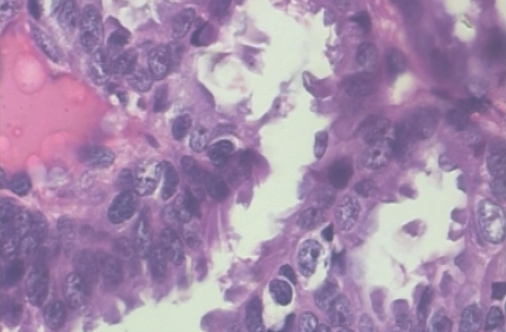
Malignant Tumors:
Invasive Ductal Carcinoma (IDC): The most common type of breast cancer, IDC begins in the milk ducts and invades nearby tissue. It forms irregular, glandular structures and can cause a palpable mass.
Invasive Lobular Carcinoma (ILC): Begins in the lobules of the breast. It is more difficult to detect on imaging and often presents as a diffuse area of thickening rather than a discrete mass.
Mucinous Carcinoma (Colloid Carcinoma): A rare subtype of breast cancer, which produces extracellular mucin. It tends to have a better prognosis and is often diagnosed in older women.
Papillary Carcinoma: A rare form of breast cancer characterized by finger-like projections of tumor cells. It is typically less aggressive than IDC and has a relatively favorable prognosis.

Slide 7
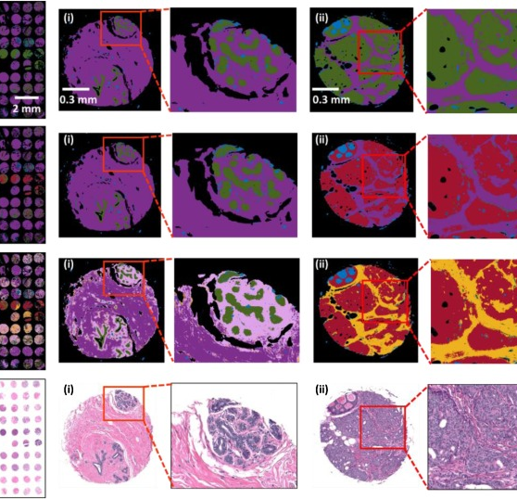
ALGORITHM
Training
Testing
Evaluation metrics
Model performance
Data Collection and Preprocessing
Prediction and Comparision with ground truth

Slide 8
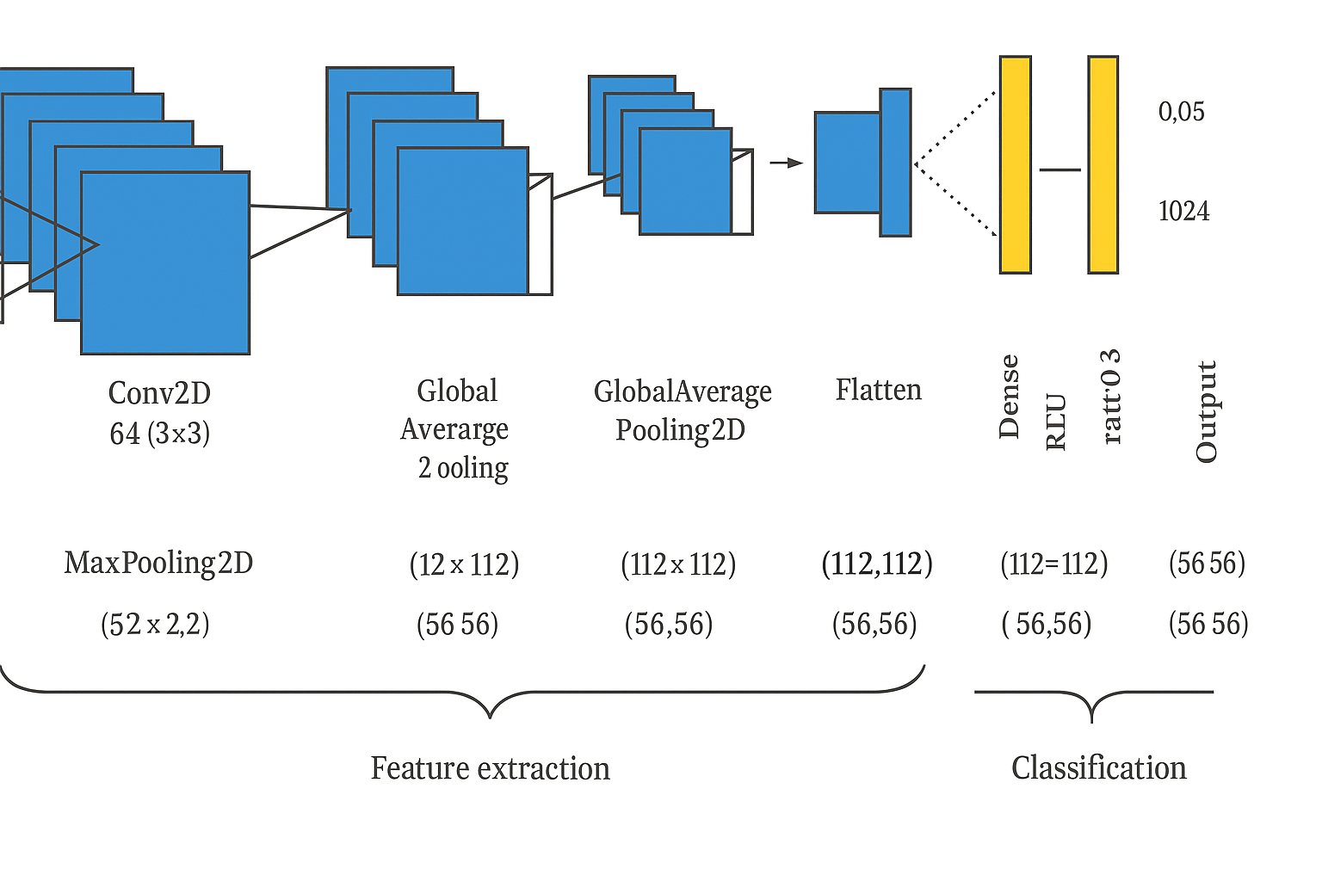
MODEL ARCHITECTURE

Slide 9
Model Evaluation and Optimization
Input Data: The histopathology images of breast tissue are fed into the model, representing either benign or malignant samples.
Conv2D (Convolutional Layer): The convolutional layer applies filters to the images to extract features like cell boundaries, textures, and other morphological patterns that differentiate benign and malignant tissues.
MaxPooling2D: This layer reduces the spatial dimensions of the images while retaining the most important features, which helps in making the model more efficient and less computationally expensive.
Flatten: Converts the 2D feature maps (from the convolutional and pooling layers) into a 1D feature vector to be processed by the fully connected layers.
Dense (Fully Connected Layer): A fully connected layer that learns non-linear combinations of features to classify the image as benign or malignant. The model’s deeper layers help in extracting higher-level features for classification.
Dropout: Randomly drops a percentage of neurons during training to prevent overfitting and help the model generalize better on unseen data.
Output Dense: The final output layer generates the probability of the input image being classified as benign or malignant, based on the features learned by the model.

Slide 10
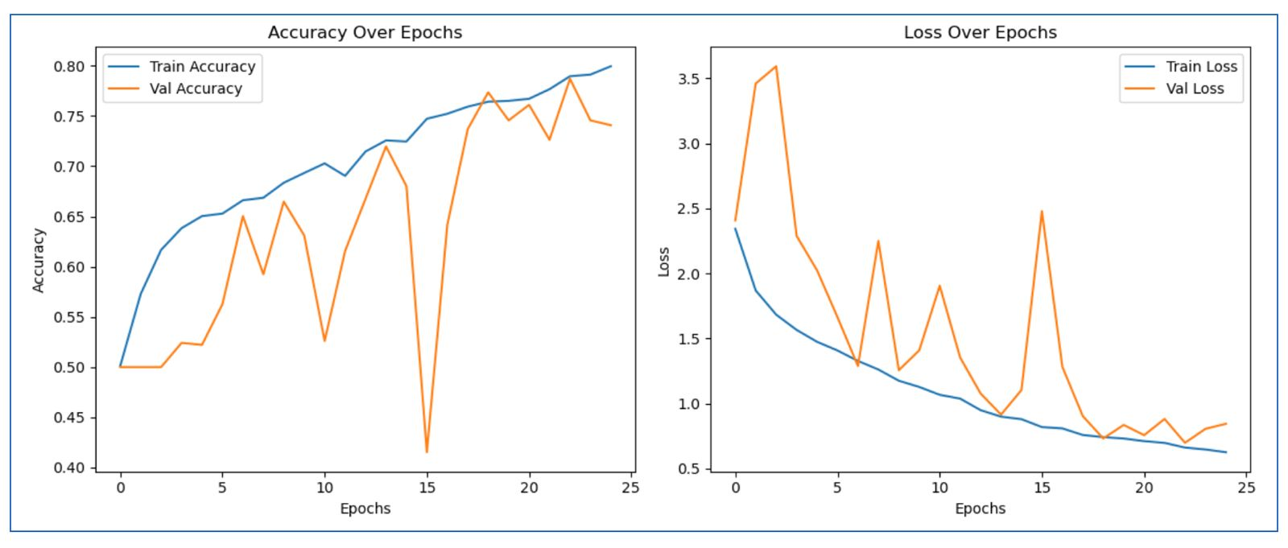
OBTAINED RESULTS

Slide 11
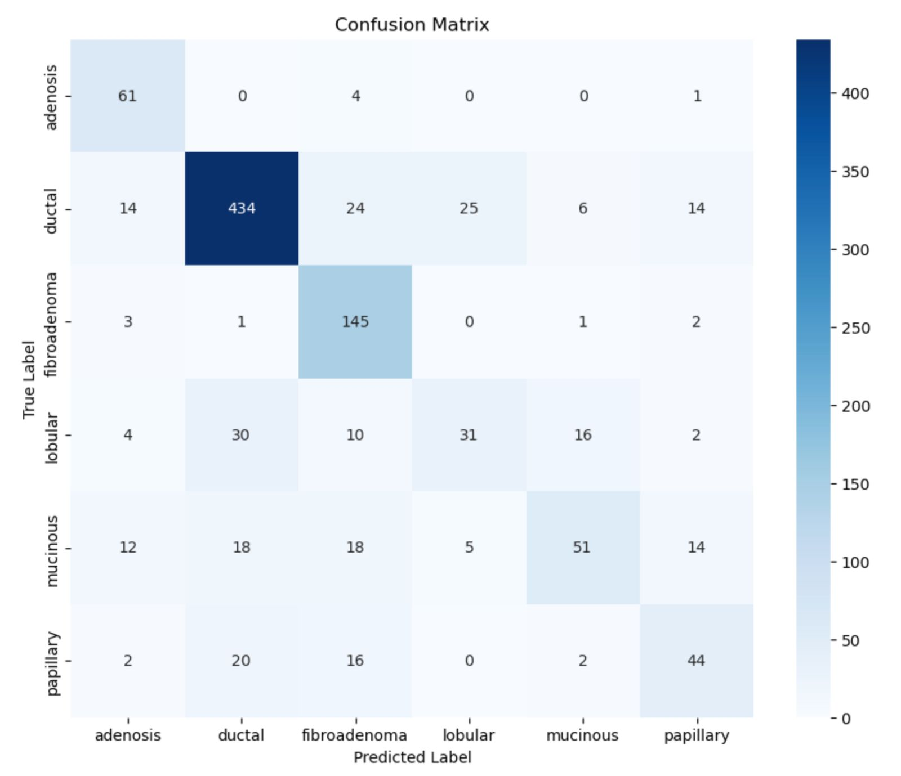

Slide 12
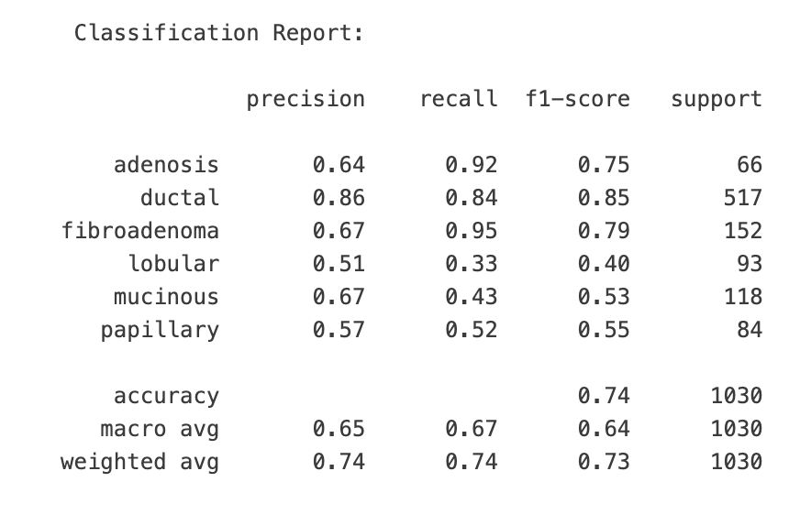

Slide 13
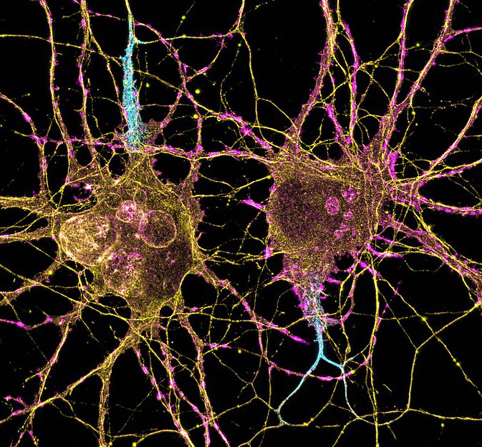
CONCLUSION & FUTURE WORK
Improve Model Accuracy We aim to further optimize model performance through advanced training techniques, deeper architectures, and better handling of class imbalance.
Incorporate Explainability Tools Applying Grad-CAM and other explainable AI methods to visualize model decisions and increase clinical trust.

Slide 14
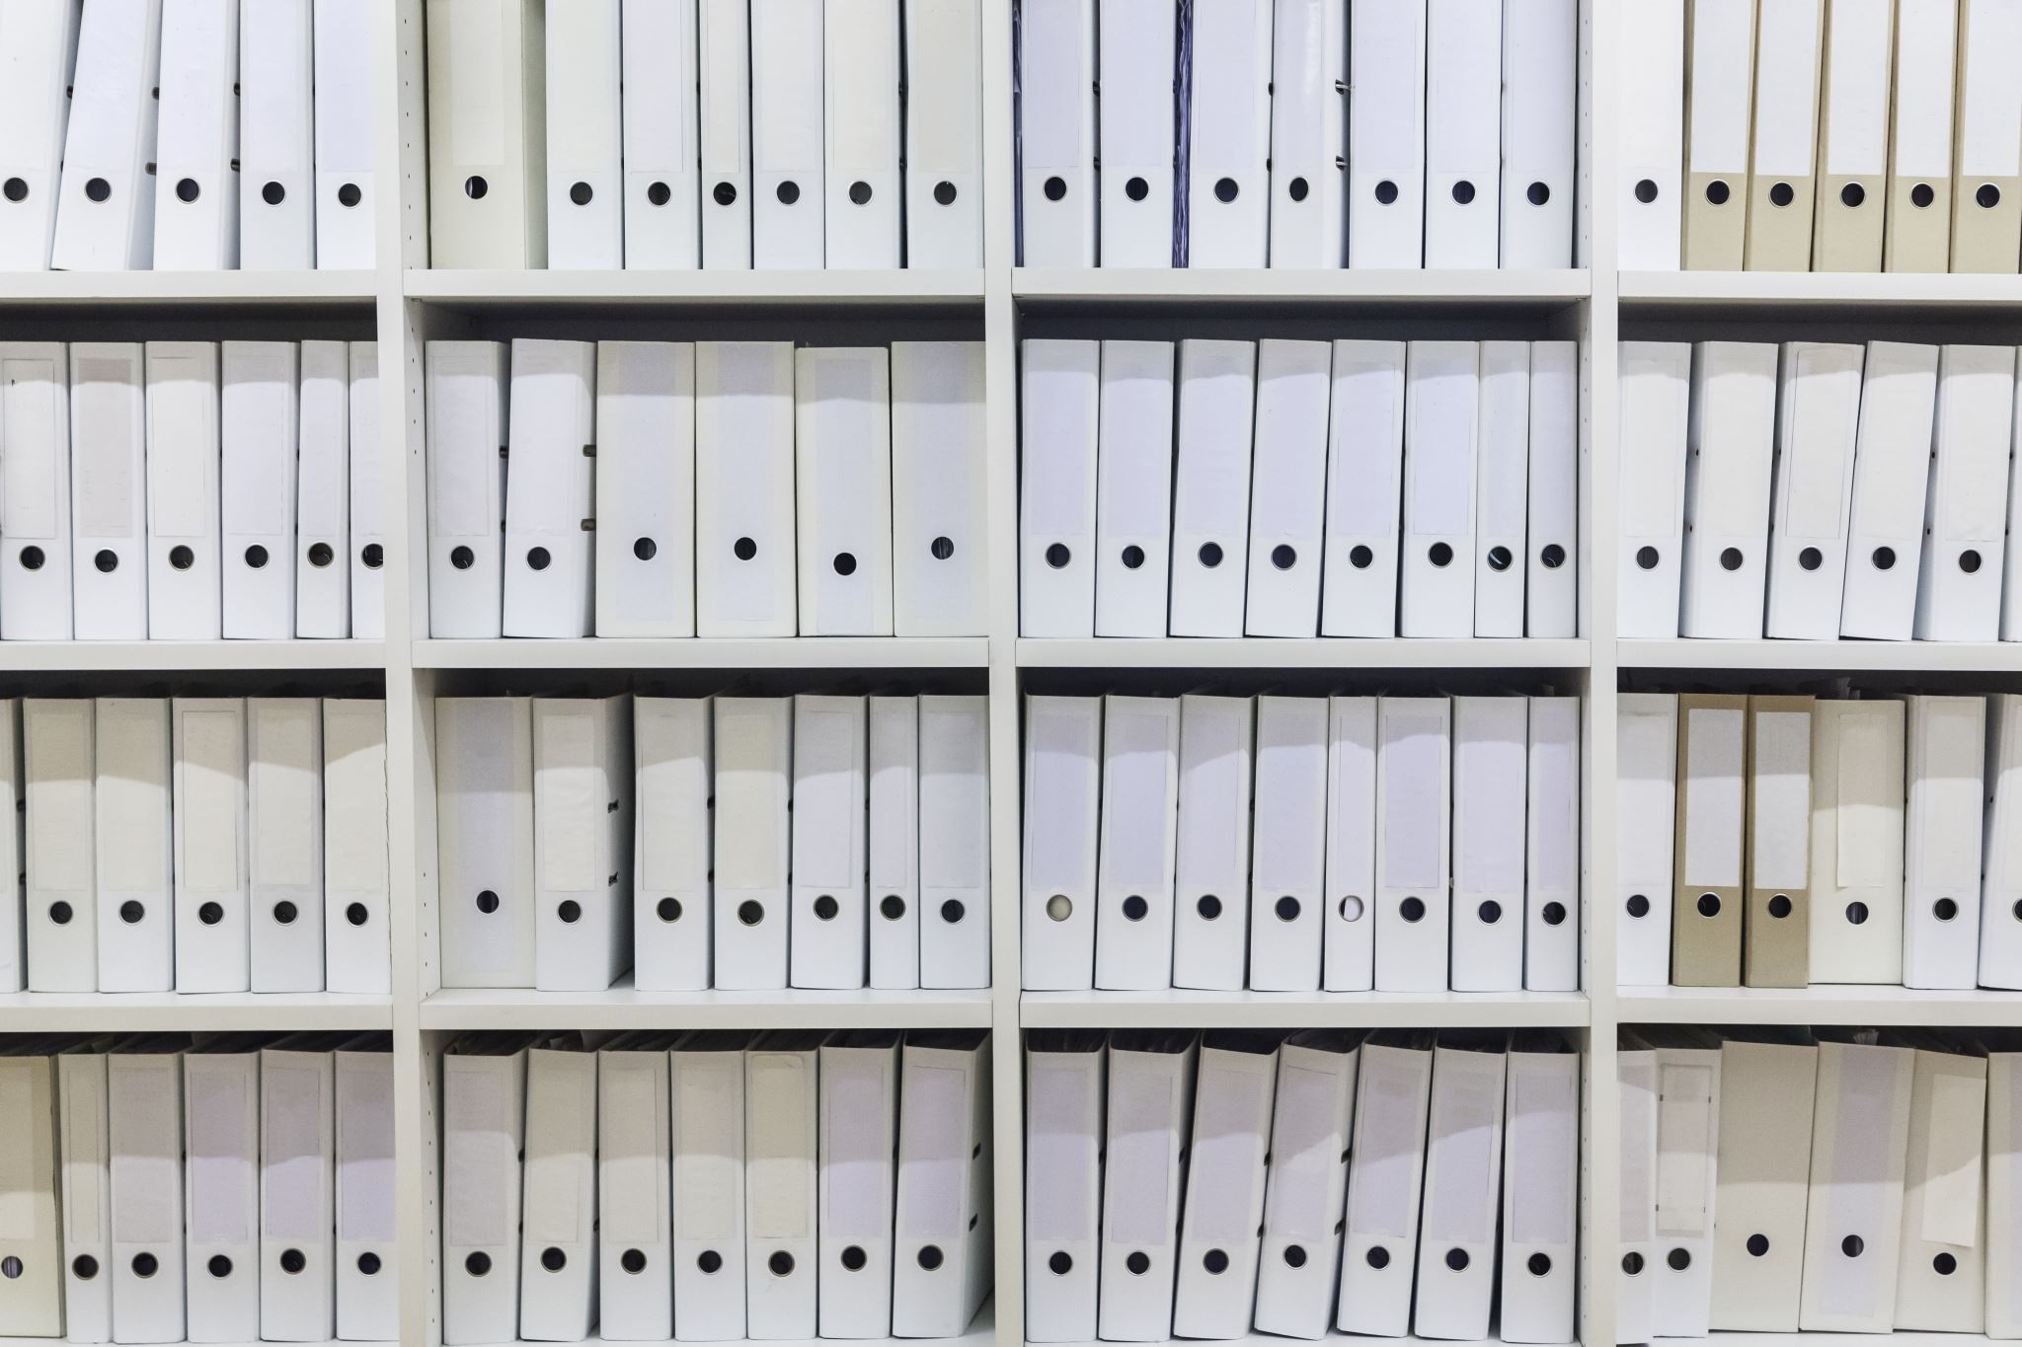
REFERENCES
1. Balasubramanian et al., 2024. Ensemble DL for subtype detection.
2. Suxing Liu, 2024. Lightweight attention ResNet (arXiv:2308.13150).
3. Sani et al., 2024. Supervised contrastive learning (arXiv:2405.03642).

Slide 15

THANK YOU

